Slide 1
MASI Tutorial San Diego 2017
Time |  | Presentation | Presenter
09:00 | Introduction | Welcome, Agenda and Admin | Jim Roberts Wing Cdr Stuart Oliver
09:15 |  | "Losing one third of a fleet, the Australian CH-47 capability" | MAJ Jason Otter, Aust Army MAJ David Wade
09:45 | Break | Solar Eclipse Break
10:45 |  | Merging Commercial and Military Requirements in an SMS | John Karstens, Boeing
11:25 |  | Accident/Incident Investigations: An opportunity for the Manufacturer to enhance the Product Safety. The Airbus DS experience | Jose Leopoldo Casado Corpas, Airbus
12:00-13:30 | Lunch
13:30 |  | Multi-Agency Cooperation in the F-18 Accident Near RAF Lakenheath | Randall Sauer, Boeing
14:15 |  | The challenges of harmonizing the protection of sensitive safety data across borders in both civil and military investigations | Olivier Ferrante - BEA France
14:30-14:50 | Break
14:55 |  | Open Forum/Panel Discussion | ALL
15:35 | Wrap-Up | Wrap-up & Conclusions | Jim Roberts< Boeing Wing Cdr Stuart Oliver (UK Defense AIB)
15:55 |  | Side Bar if Needed | ALL
16:15 | Adjourn |  | ALL

Slide 2
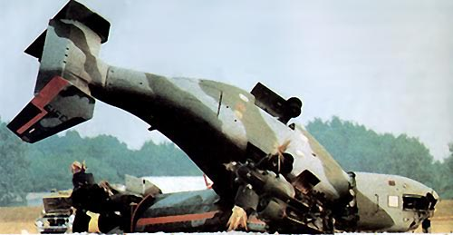
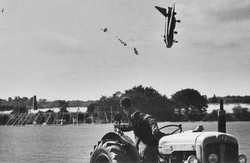
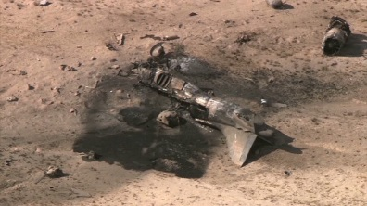
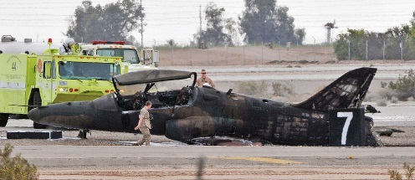
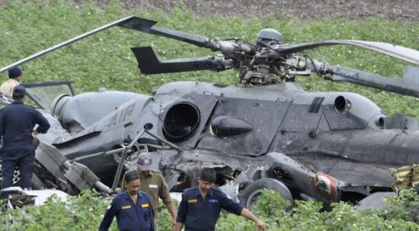
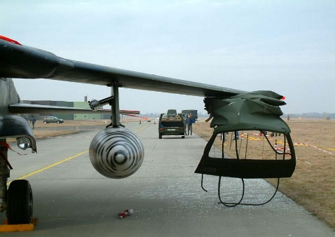
Military Tutorial
Military Air Safety Investigation Conference
Olivier Ferrante, BEA French Safety Investigations
Wing Commander Stuart Oliver, UK Defence AIB
Jim Roberts, Boeing ASI/ASE
Dave Harper, USAF Safety Center
CDR Rob Stevenson, USN Safety Center
NOTE: Images used in this presentation are for educational or illustrative use, only, and have been culled from open rights sources. All rights reserved by any individual copyright owners where noted.
Export Authority; Reference NLR; (EAR99) These commodities, technology, or software are controlled for export from
the United States in accordance with the Export Administration Regulations. Diversion contrary to US law is prohibited.

Slide 3
Disclaimer Statement
Tutorial: Military Accident Investigations
Forum for International Military Accident Investigators to share knowledge on their respective capabilities, experiences, processes and procedures with a view to the development of future relationships and common practices. It follows the inaugural meeting of the European Military Air Safety Investigators Forum which took place on 17 April 2013 and the three Military Air Safety Investigation Tutorials held during ISASI 2013, ISASI 2015, and ISASI 2016.
These forums/tutorials drew growing numbers of military investigators from across Europe, Australia, North America and Asia seeking to share their safety lessons. On 19-21 April 2016 in Albuquerque (New Mexico, USA), the Military Aviation Safety Workshop will address "Sharing Safety Lessons to Preserve Military Readiness".
The other goal of linking this tutorial to the 48th ISASI seminar is to benefit from the experience gained by the civil counterparts over the years.
The main outputs of the presentations and discussions of this workshop will also be presented during the ISASI plenary session.
The next MASW will be held in Daytona Beach, FL 17-19 April 2018 and hosted by Embry-Riddle Aeronautical University

Slide 4
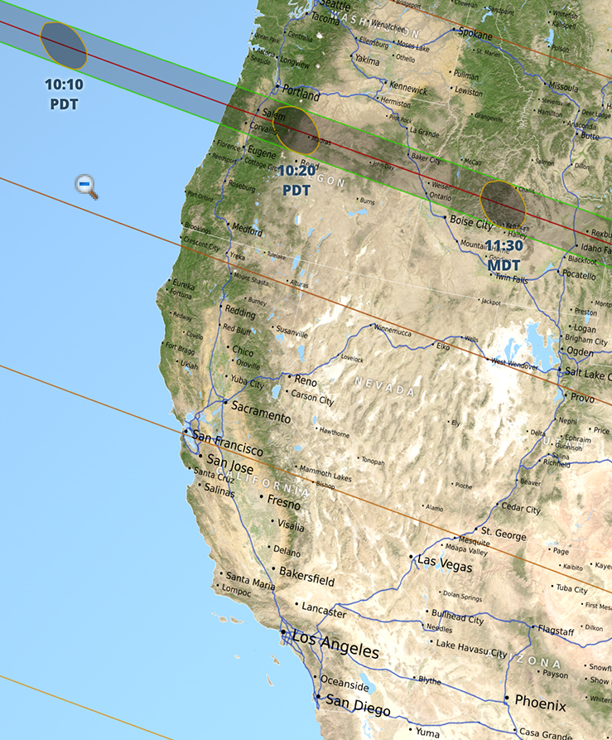
Solar Eclipse – San Diego, CA
The eclipse will be visible in San Diego:
Starting at 9:07 a.m., the moon begins to pass in front of the solar disk and appears to “touch” the sun.
At 10:23 a.m., the eclipse will reach its maximum point of visibility, when the axis of the moon’s shadow cone passes closest to the center of Earth.
11:45 a.m. is when the outer edge of the moon last “touches” the sun, signaling the end of the eclipse.

Slide 5


Solar Eclipse

Slide 6
MASI/ISASI Purpose & Theme
MASW: Embry-Riddle, Daytona Beach, FL 17-19 APR 2018
  “Sharing Safety Lessons Learned to Preserve Military Readiness
Year | Host | Location | MASW # of Days
2012 | Boeing* (no International ASI’s) | Tempe, AZ | 3 Days
2013 | ISASI/MASI combined | Vancouver, CAN | 1 Day with ISASI
2013 | ESASI | Madrid, Spain | 1 Day with ESASI
2015 | ISASI/MASI combined | Augsburg, Germany | 1 Day with ISASI
2016 | USAF Safety Center - MASW | Albuquerque, NM | 3 Days
2016 | ISASI/MASI-International Europe | Reykjavik, Iceland | 1 Day with ISASI
2017 | ESASI | Ljubljana, Slovenia | 1/2 Day with ESASI
2017 | ISASI/MASI | San Diego, CA | 1 Day with ISASI
2018 | Embry-Riddle MASW | Daytona Beach, FL | 3 Day
2018 | ESASI | Riga, Latvia | ½ Day with ESASI
2018 | ISASI | Dubai | ISASI Conference
  * Military Air Safety Investigators (MASI) subset of International Society of Air Safety Investigators (ISASI)

Slide 7
MASI 2017 Tutorial Agenda

Slide 8
MASI Tutorial San Diego 2017
Time |  | Presentation | Presenter
09:00 | Introduction | Welcome, Agenda and Admin | Jim Roberts Wing Cdr Stuart Oliver
09:15 |  | "Losing one third of a fleet, the Australian CH-47 capability" | MAJ Jason Otter, Aust Army MAJ David Wade
09:45 | Break | Solar Eclipse Break
10:45 |  | Merging Commercial and Military Requirements in an SMS | John Karstens, Boeing
11:25 |  | Accident/Incident Investigations: An opportunity for the Manufacturer to enhance the Product Safety. The Airbus DS experience | Jose Leopoldo Casado Corpas, Airbus
12:00-13:30 | Lunch
13:30 |  | Multi-Agency Cooperation in the F-18 Accident Near RAF Lakenheath | Randall Sauer, Boeing
14:15 |  | The challenges of harmonizing the protection of sensitive safety data across borders in both civil and military investigations | Olivier Ferrante - BEA France
14:30-14:50 | Break
14:55 |  | Open Forum/Panel Discussion | ALL
15:35 | Wrap-Up | Wrap-up & Conclusions | Jim Roberts< Boeing Wing Cdr Stuart Oliver (UK Defense AIB)
15:55 |  | Side Bar if Needed | ALL
16:15 | Adjourn |  | ALL

Slide 9
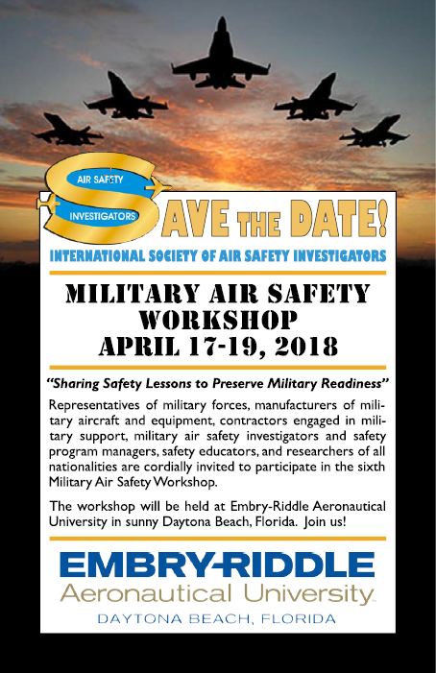

Slide 10
MASI/ISASI Purpose & Theme
MASW: Embry-Riddle, Daytona Beach, FL 17-19 APR 2018
  “Sharing Safety Lessons Learned to Preserve Military Readiness
Year | Host | Location | MASW # of Days
2012 | Boeing* (no International ASI’s) | Tempe, AZ | 3 Days
2013 | ISASI/MASI combined | Vancouver, CAN | 1 Day with ISASI
2013 | ESASI | Madrid, Spain | 1 Day with ESASI
2015 | ISASI/MASI combined | Augsburg, Germany | 1 Day with ISASI
2016 | USAF Safety Center - MASW | Albuquerque, NM | 3 Days
2016 | ISASI/MASI-International Europe | Reykjavik, Iceland | 1 Day with ISASI
2017 | ESASI | Ljubljana, Slovenia | 1/2 Day with ESASI
2017 | ISASI/MASI | San Diego, CA | 1 Day with ISASI
2018 | Embry-Riddle MASW | Daytona Beach, FL | 3 Day
2018 | ESASI | Riga, Latvia | ½ Day with ESASI
2018 | ISASI | Dubai | ISASI Conference
  * Military Air Safety Investigators (MASI) subset of International Society of Air Safety Investigators (ISASI)

Slide 11
Wrap Up
Presenters
Keynote message
Future Conferences
Presentation | Keynote Message
MAJ Otter MAJ Wade
John Karstens
Jose Leopoldo
Randall Sauer
Olivier Ferrante
Panel Discussion
Notes:
The purposeful development of techniques and procedures for utilizing UAS, along with the convergence of related technological capabilities, promises a significant enhancement to traditional methods of aircraft accident investigations. Additionally, the UAS capabilities above directly relate to components of SMS; following the SMS process will continue to increase safety to all team members involved in an investigation. The results of the investigation will also allow aviation to transition from a reactive to proactive, and finally, predictive safety environment.
The authors feel that additional study into the practical use of
We can foresee evaluations conducted under representative and realistic conditions to the maximum extent possible; programs should consider operating terrain, the use of actual wreckage or test parts to evaluate effectiveness, and integration into incident reporting systems for first responder and accident investigator real-time dissemination and situational awareness.

